Slide 1

Examining Netflix original programming
Completed by Lakshmi Shaji, Patrick Minnig, Bethany Morton, and Stefan Johnson

Slide 2
Data Sources
Kaggle csv file
Wikipedia Webscrape
Rotten Tomatoes webscrape

Slide 3
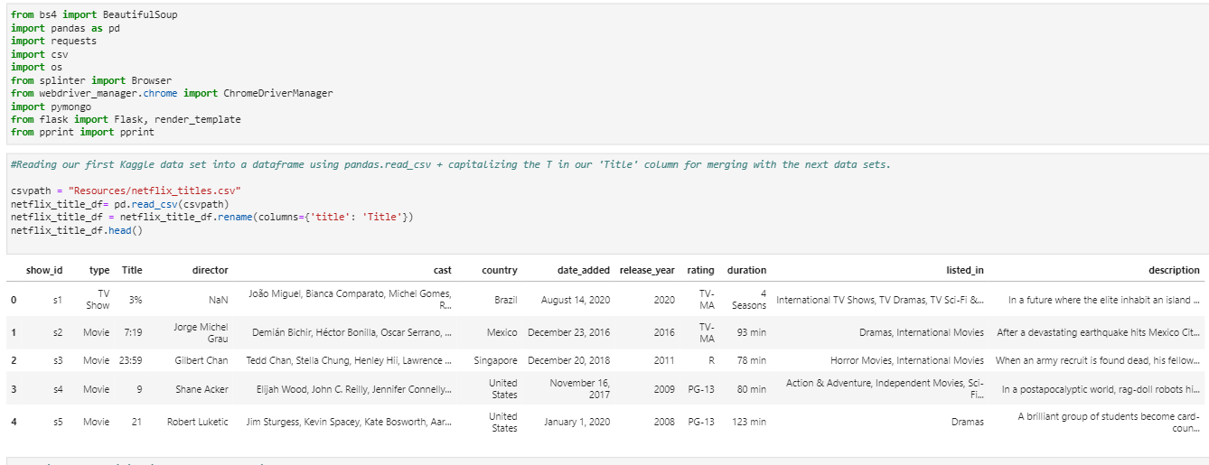
Reading in Kaggle Data Set

Slide 4
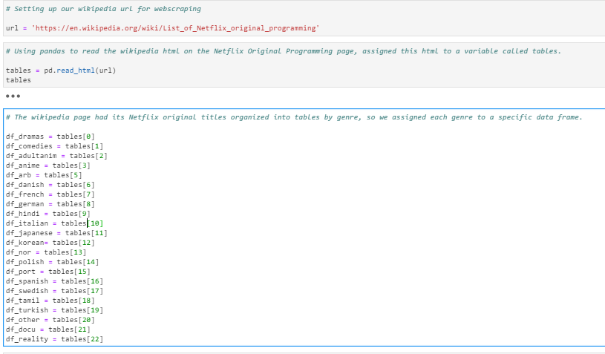
Loading In The Wikipedia Data

Slide 5
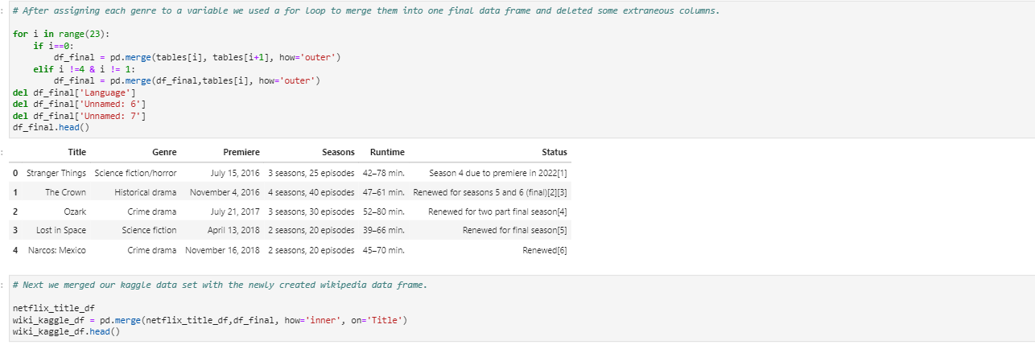
Merging tables

Slide 6
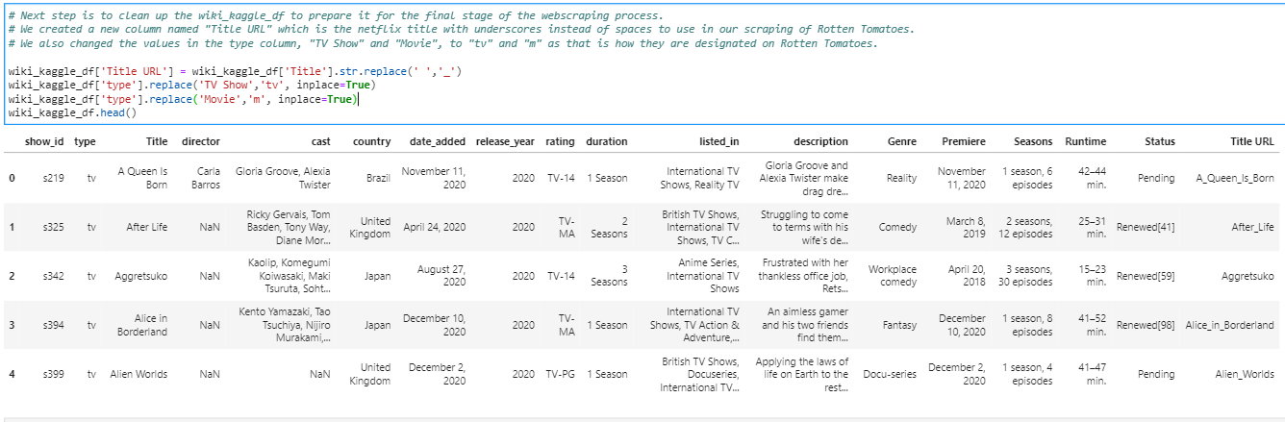
Cleaning data frames

Slide 7
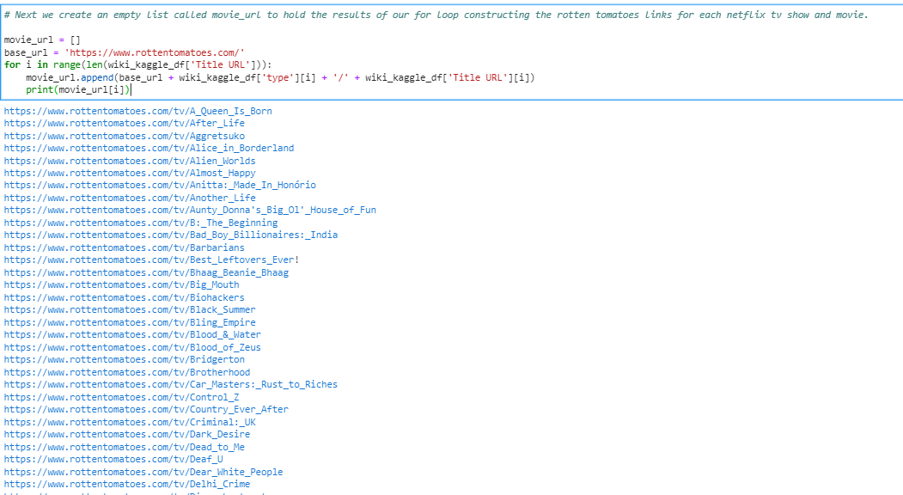
Constructing links from data frames
Building our URLs for web scraping

Slide 8
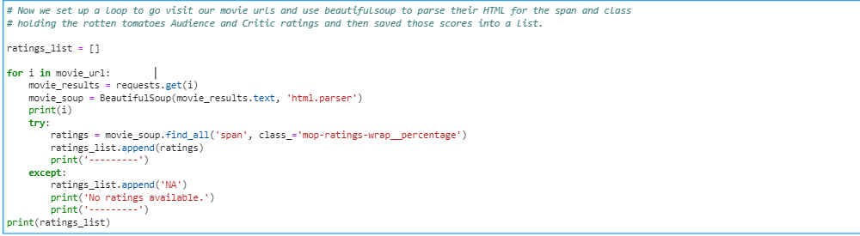
A BeautifulSoup Loop
Scraping Rotten Tomatoes for the tomatoer and audience reviews

Slide 9
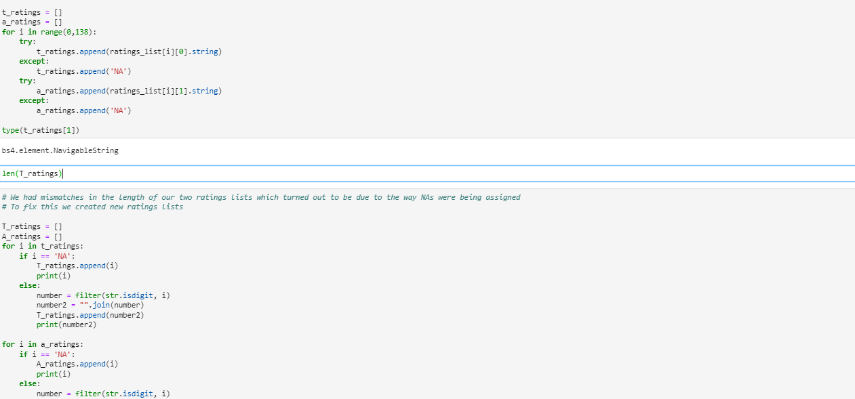
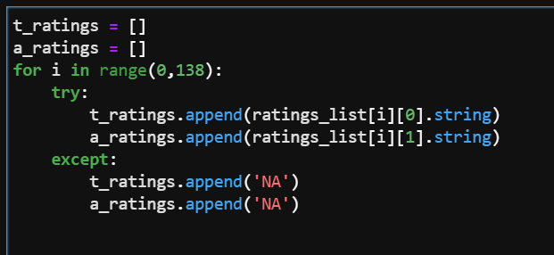
Troubleshooting
Creating separate lists for tomatoer and audience reviews
Old Code
Removing all non-digits from the scores

Slide 10
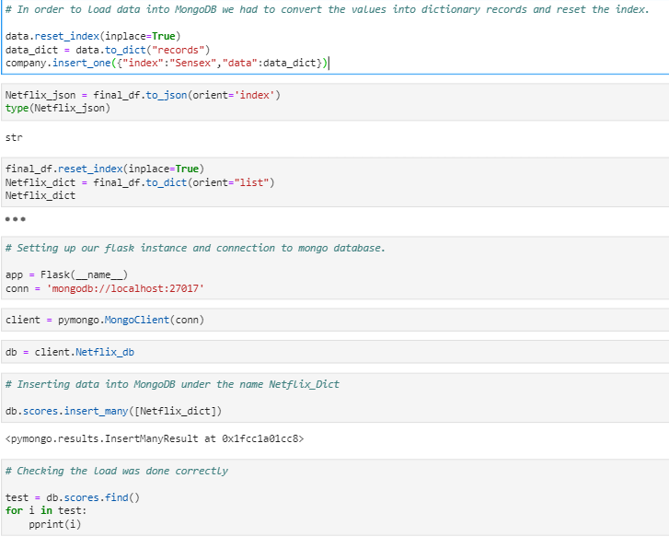
Loading into MongoDB

Slide 11
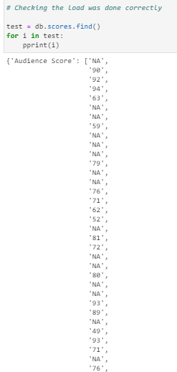
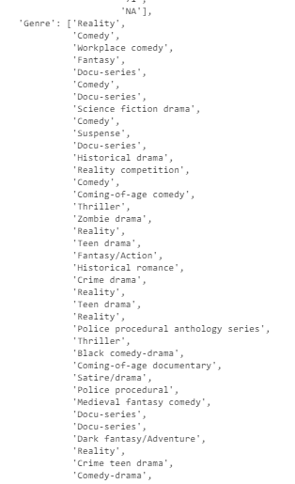
Confirming Results

